Slide 1

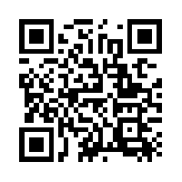
Quantum Communications Group
KML - authentication
Documentation status
Group Coordinator:
Armando Nolasco Pinto
anp@ua.pt
Group Websites:
https://www.it.pt/Groups/Index/72
LinkedIn: https://www.linkedin.com/company/quantum-communications-group-it-av/
Diogo Matos

Slide 2
Device/app identification and authentication
Each device need to be identified by a certificate (X.509) chain. It includes all certificates from a trusted root certificate authority (CA) certificate, these certificate chain is linked to a device-specific leaf certificate. The certificate must have PQC support.
Authentication process (CHAP based):
1 - request certificate and verify it;
2 - send a challenge (nonce) to be signed and verify the signature.
Algorithms:
Digital signature - Falcon-512 / Dilithium 2 (or 3) (both in NIST’s 1st four quantum-resistant algorithms announcement)

Slide 3

Token based authentication
A token is generated after authentication for a specific ‘user’. That token can be used multiple times during a period of time and gives authorization to access a specific set of services/data.
This can be used, for example, between the secure apps and KMS api. This way the api doesn’t need to worry about authentication and authorization, only need to ask the auth server for verification of the token.
There is two big options OAuth and JWT (RFC 7519).

Slide 4
The PQC problem
No one doubts the need for PQC (and PQA in general) as the threat of quantum computer is as near as ever;
Those algorithms are critical and undergo a lot of tests over a long period of time before they can be considered as “secure”;
Any system that wants to incorporate PQC need to be aware that the future of those algorithm is unknown. The system must not completely rely on them.
One good sign of the security status of a cryptographic algorithm are its certifications. Today there is only 4 PQC algorithms verified by NIST.

Slide 5
TLS 1.3 - Hybrid Solution
“The primary goal of a hybrid key exchange mechanism is to facilitate the establishment of a shared secret which remains secure as long as one of the component key exchange mechanisms remains unbroken”
Negotiation
Both sides need to agree on the algorithm to be used. Each one sends a list (supported_groups) of ids of one or multiple (hybrid) algorithms. At this point backwards compatibility is insured.
Transmission of public keys & ciphertexts
Keys/ciphertexts from each algorithm are concatenated and ent the way they usually are.
Shared secret calculation
The two shared secrets are concatenated together and used as the shared secret in the existing TLS 1.3 key schedule.
!! Public keys and ciphertexts are limited to 2^16-1 bytes
Defined hybrid groups:
x25519, kyber768
secp384r1, kyber768
x25519, kyber512
secp256r1, kyber512

Slide 6

Machine-to-machine authentication
Inside a QKD node there is multiple services running that communicate with each other, providing and retrieving data from one another. This can be seen as a typical case of the use of microservices.
Each service, in order to interact with others, need to prove his identity as an authorized service.
Services like the KMS, the QKD device, the RNG and the SDN agent, all run inside every node and need each other. They can be considered microservices bellow the main service that provides keys to the secure apps.

Slide 7
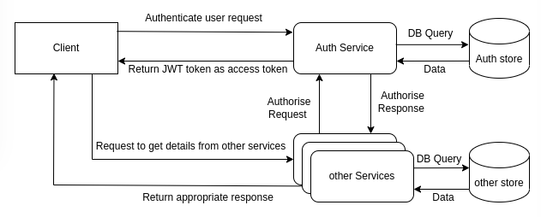
Microservices authentication and authorization
This usually involves a central authentication service that receives authentication requests and provides tokens (JWK e.g.) to be used when accessing other services. Those tokens have and identity and a set of authorizations attached to it.
Signature used inside the JWK tokens uses asymmetric cryptography. Maybe would be better use PQ digital signature algorithms or use a KEM in order to create a shared key between the service and the Auth Service.

Slide 8
References
2022, Yao, Post Quantum Design in SPDM for Device Authentication and Key Establishment
1981, Wegman, New hash functions and their use in authentication and set equality
2023, Patel, Authentication & Authorization in a microservices architecture
Auth0, Introduction to JSON Web Tokens
2023, Stebila, Hybrid key exchange in TLS 1.3

Slide 9
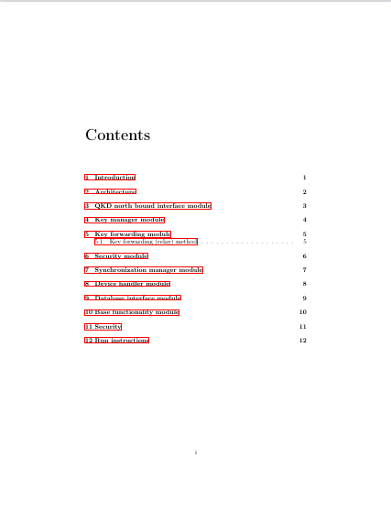
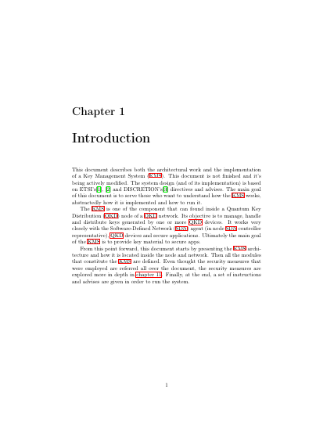
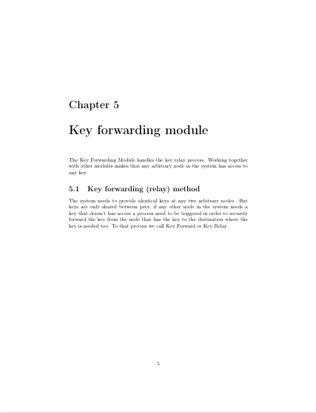
KML documentation

